Slide 1

Database Warehouse And Business Intelligence
Medicare Provider Utilization And Payment Data
Team 3: Golden Trio
Karan Desai (NUID: 001492087)
Shaishav Shah (NUID: 001447053)
Parth Rana (NUID: 001417553)

Slide 2

Objective
Analyze cost and treatment KPIs of different types of health service provider and also, analyze the nursing home facilities condition and Inpatient healthcare conditions.

Slide 3
Data Source
Data was collected from from CMS website. The data set consist of five (5) files which were linked with each other based on their Provider ID over 2015 and 2016 year.
Medicare Provider Utilization and Payment Data: Skilled Nursing Facilities
Medicare Provider Utilization and Payment Data: Hospice Providers
Medicare Provider Utilization and Payment Data: Home Health Agencies
Medicare Provider Utilization and Payment Data: Outpatient
Medicare Provider Utilization and Payment Data: Inpatient
For all datasets key column is : Provider ID

Slide 4
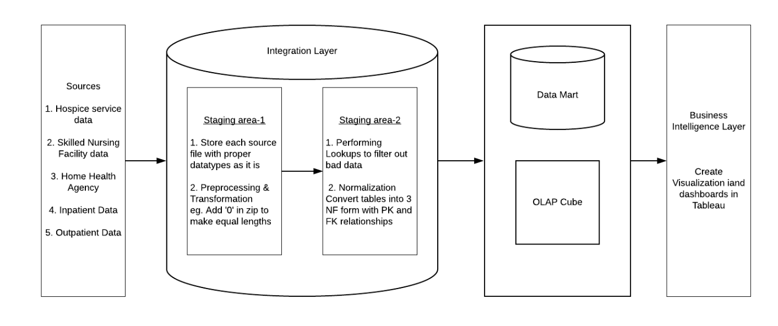
Data and Process Flow

Slide 5
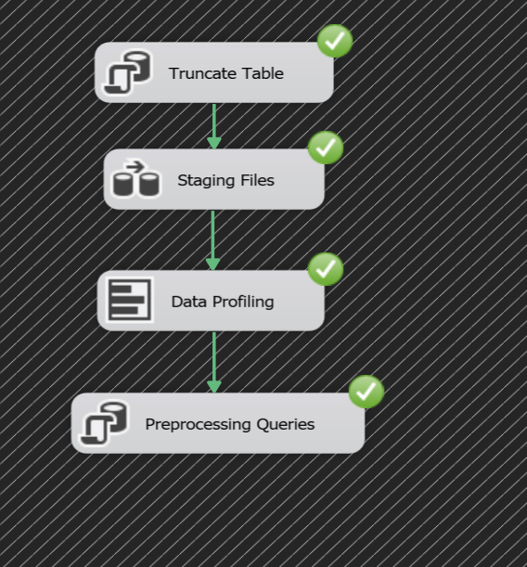
Data Profiling and Preprocessing
Automated Data Profiling using in-built tool and SSIS Package
Customised Pre-processing queries according to the report generated

Slide 6
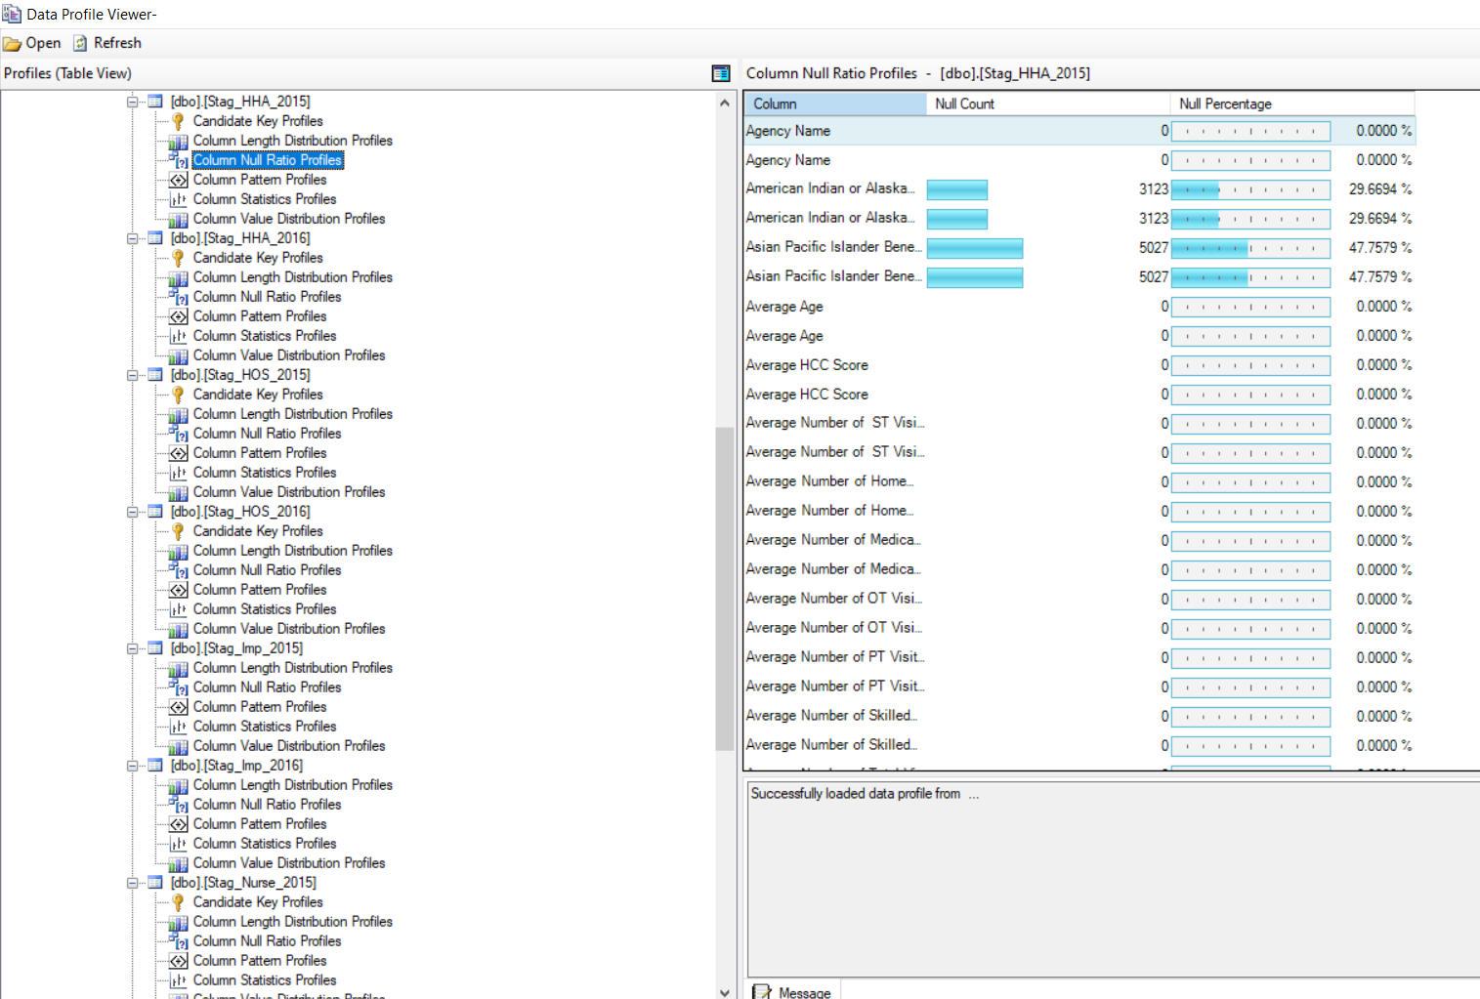
Data Profiling and Preprocessing

Slide 7
Summary of Data Profiling
Some of our observations were:
Zip Code were of 4 digits and 3 digits instead of 5 digits Example: 02215 becomes 2215
According to the definition, Provider ID was an unique 6 digit number. However, there were many Provider IDs which having only 5 digits.
There were few NULL values in the important columns like Zip Code, State Etc.
Data source was not consistent with Name. For example, few Provider Names were in Upper Case while Few were in lower case.

Slide 8
Summary of Data Preprocessing
Data Preprocessing is important for data consistency. In order to make data pure and consistent, few of the techniques where used:
Since the Provider ID and Zip Code where of data type integers in the data source, the initial “0” were removed automatically in the data. We changed the data type to “varchar” and using the concatenating technique appended “0” in the required field
We removed Null values from the fields like Provider ID, State, City, APC Details, and Drug Details.
In order to maintain the naming consistency, we made all the rows of Provider Name, Street Address, and City lowercase and State Upper Case
We trimmed out white spaces and unwanted characters from important columns like Drug Definition which was leading to duplicate values.

Slide 9
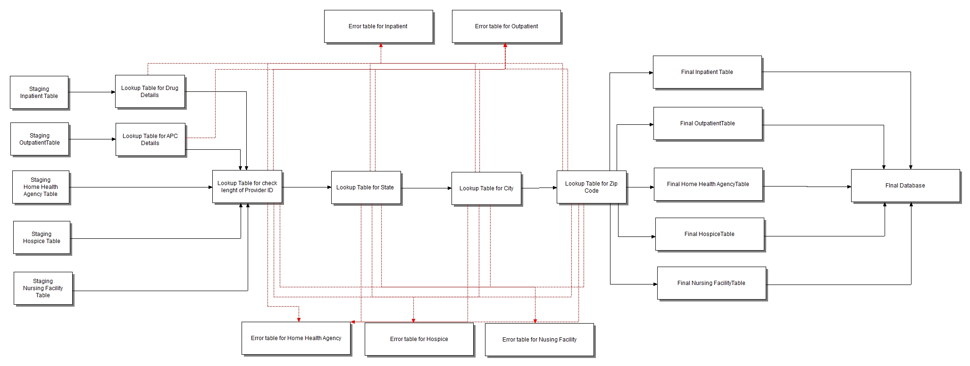
Error Handling - Lookup Tables (Staging-2)

Slide 10
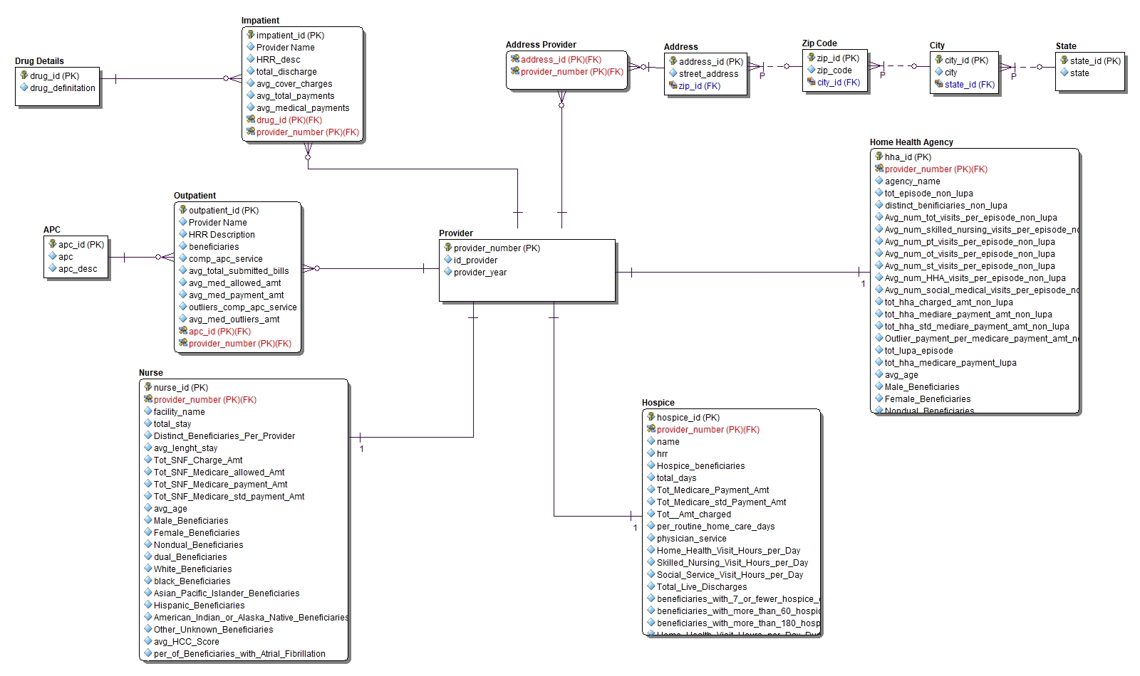
Data Schema - Physical Model (ERD Model)

Slide 11
Unique ID Creation
We created an unique Id field using provider key and year of the data.
E.g. For provider id ‘100010’ and year 2015, the unique id is 1000102015.
This unique key is used as an primary key as the primary key in the destination table.

Slide 12
Data Loading for ERD
Data Flow Diagram was loading the data from source into our Data Schema.
Data Schema was designed with the help of ERStudios.
We used Visual Studio Integration Package (SSDT) to data integration.

Slide 13
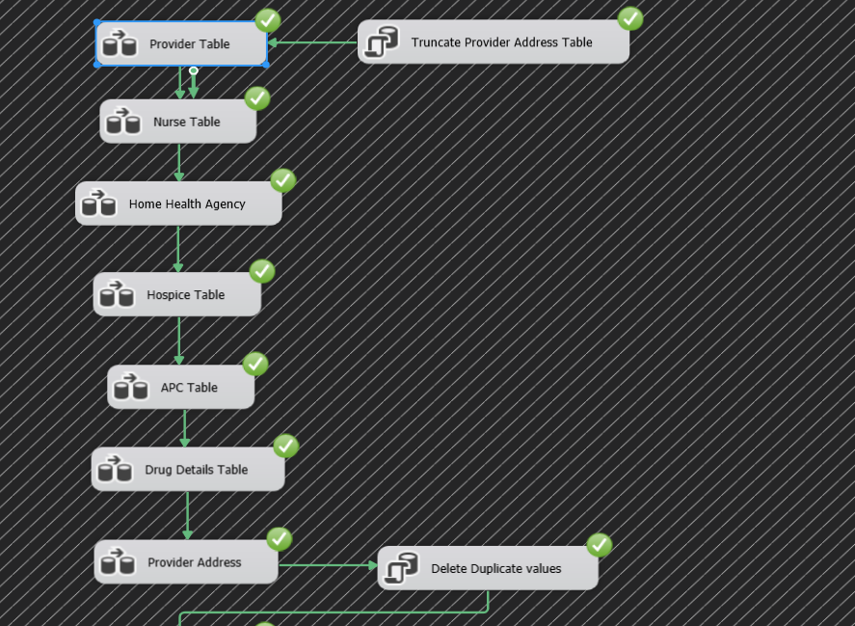
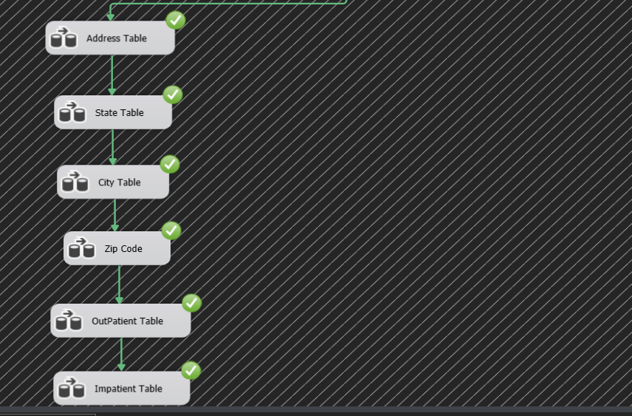
Visual Studio’s SSIS View

Slide 14
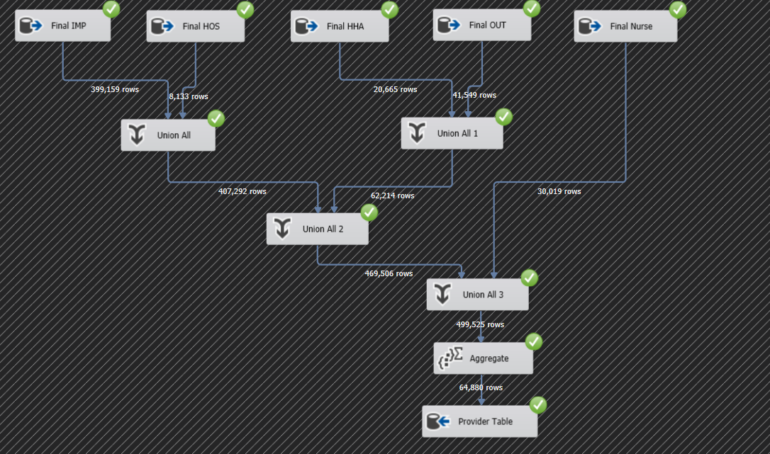
Data Flow for Provider Table

Slide 15
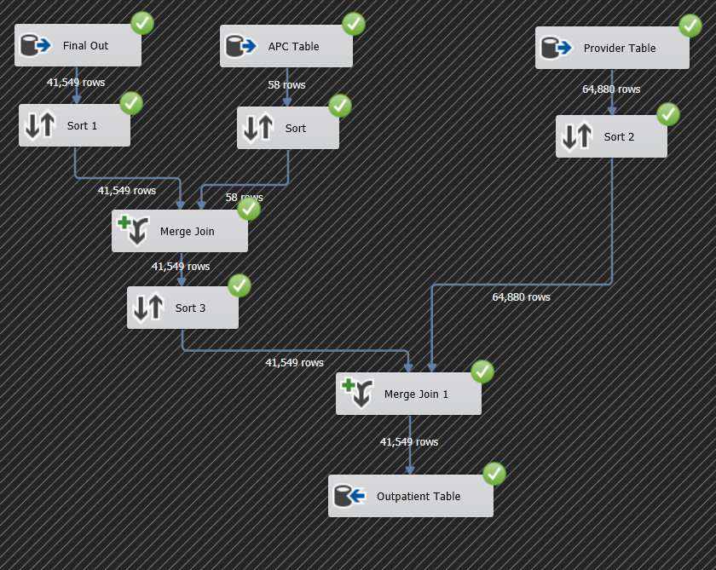
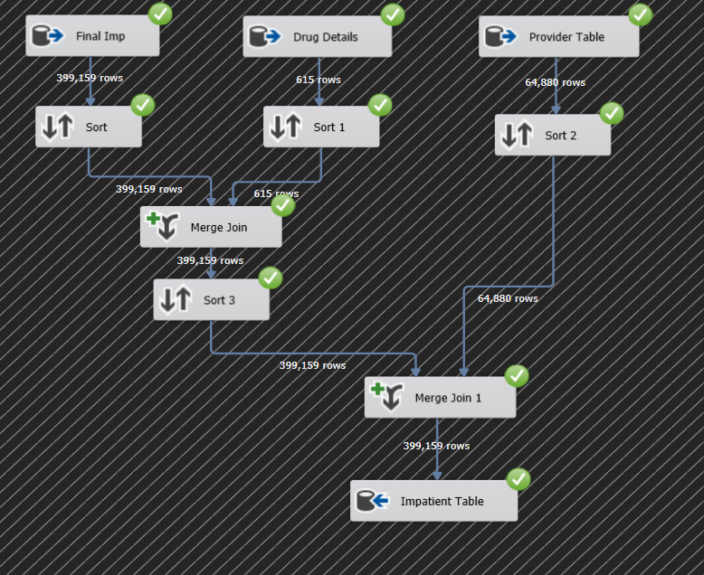
Data Flow for Inpatient and Outpatient Table

Slide 16
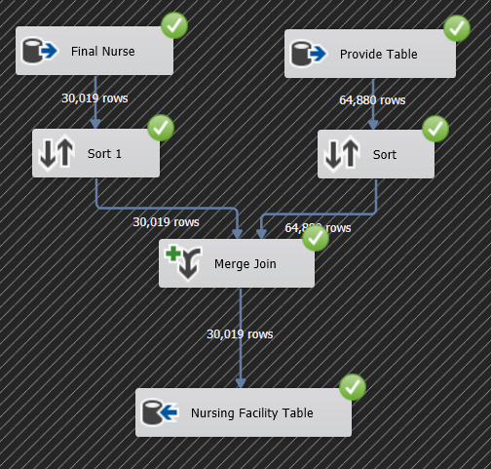
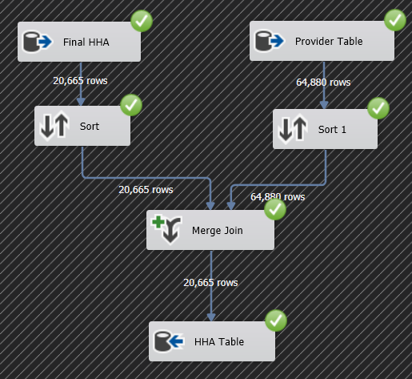
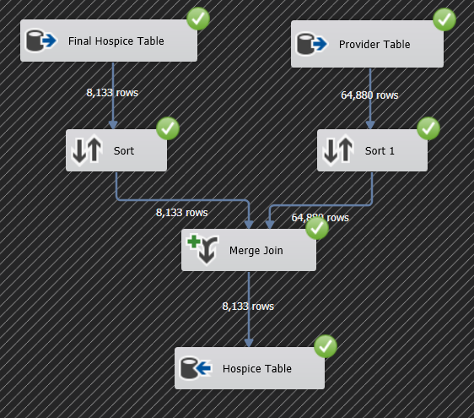
Data Flow for Nursing, Hospice and Home Health Agency Table

Slide 17
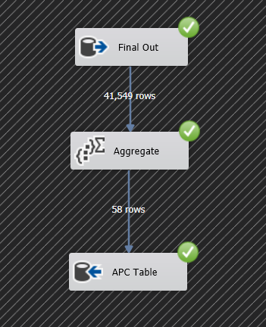
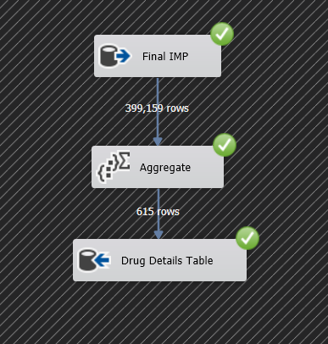
Data Flow for APC Details and Drug Details Table

Slide 18
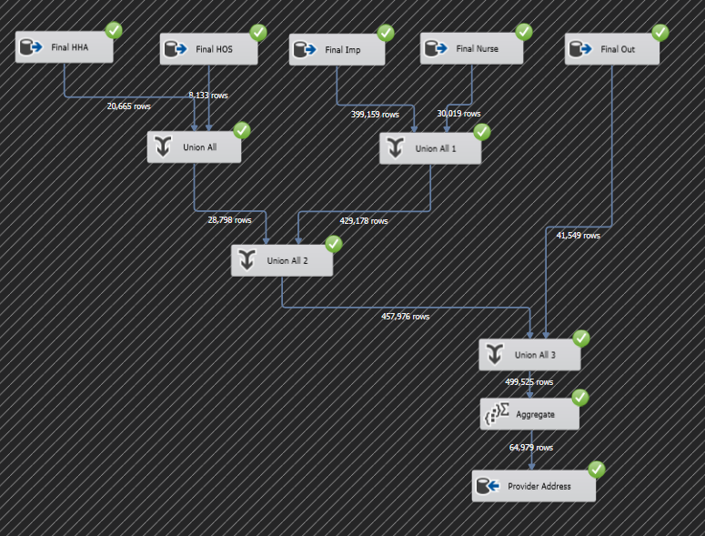
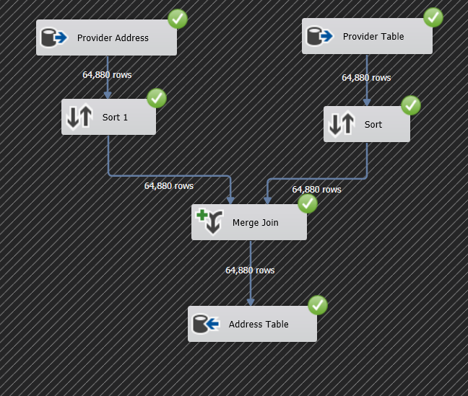
Data Flow for Provider Address and Address Table

Slide 19
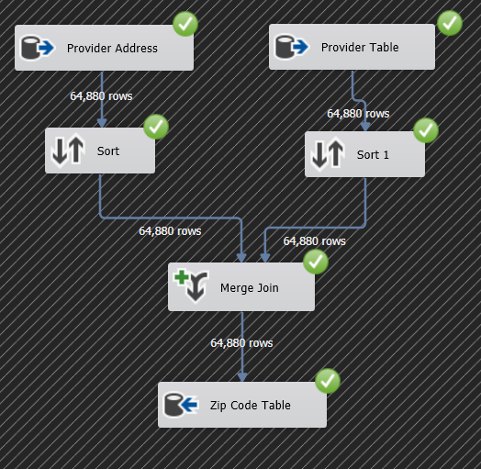
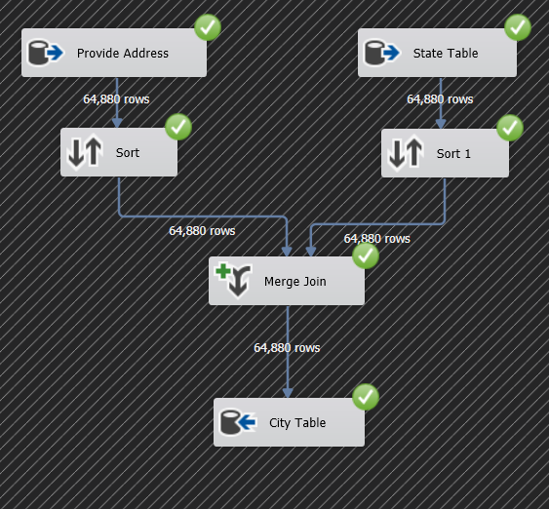
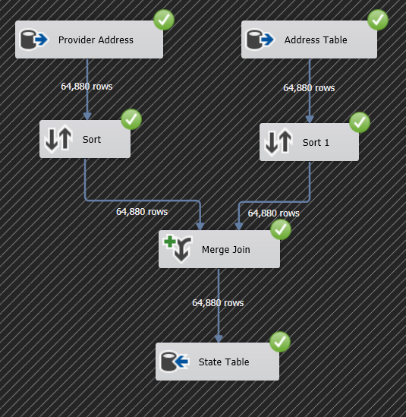
Data Flow for Zip Code, City, and State Tables

Slide 20
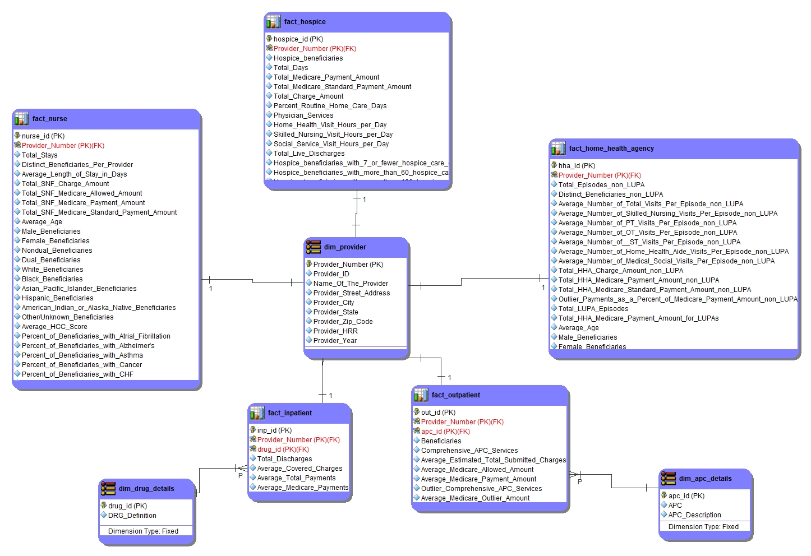
Data Mart : Dim Fact Model
ERStudio
5 Fact Table
3 Dimensions
Purpose:
Dim Fact Model
Multidimension
Data Mart
Visualization

Slide 21
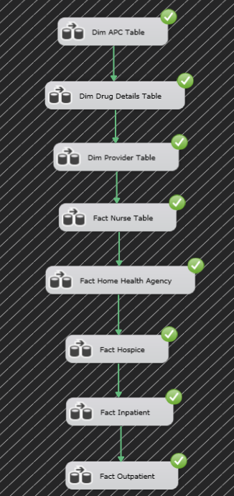
ETL SSIS Package
Software:
Visual Studio
Purpose:
Table Creation
Relationship (Parent-Child)
Data Loading (From ERD Schema)

Slide 22
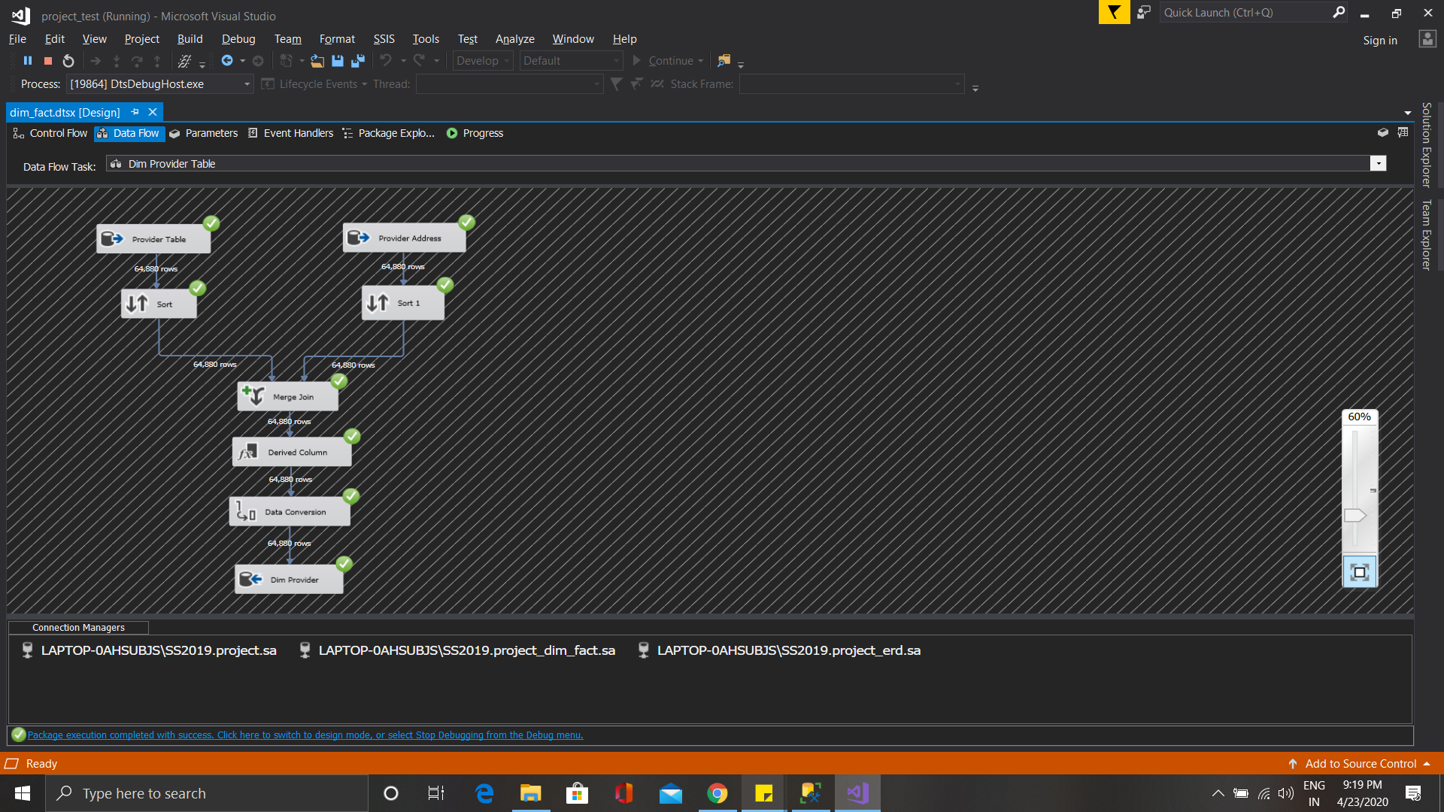
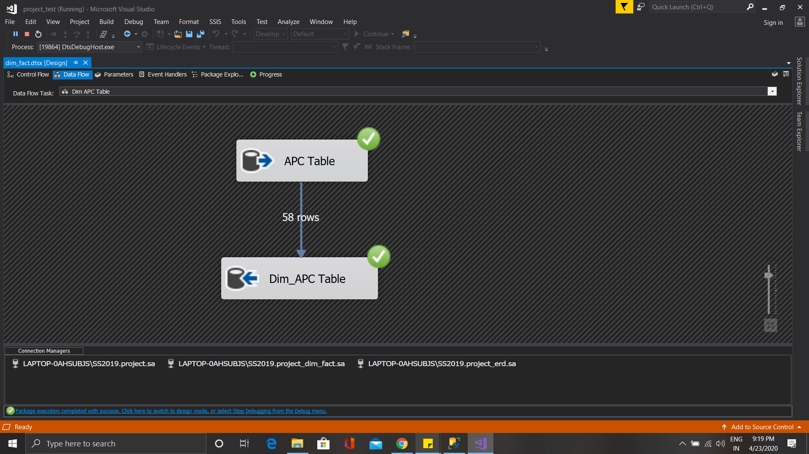
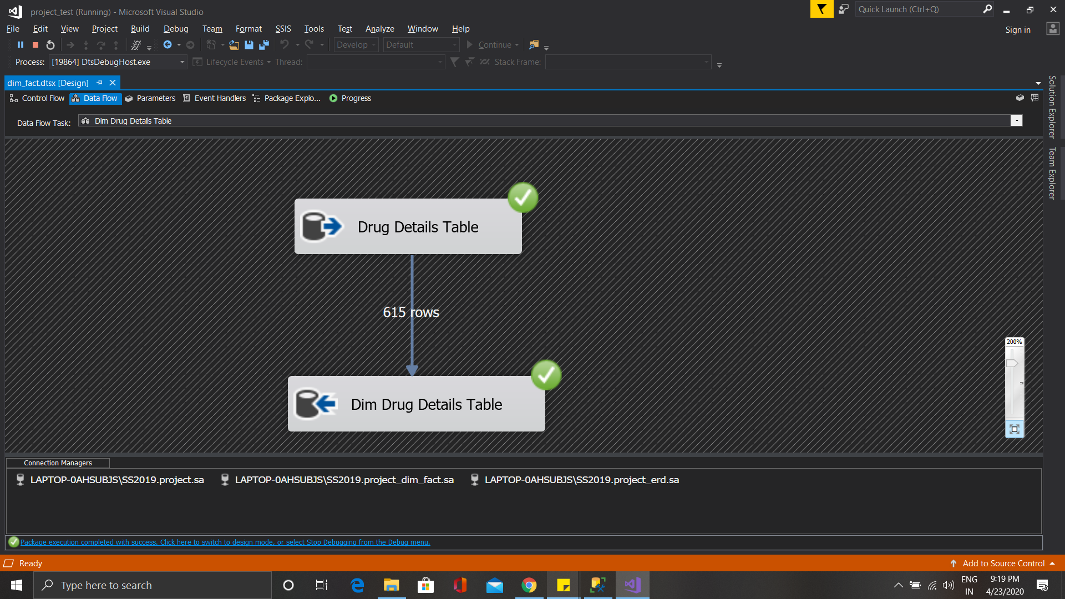
Dimension Table for Fact-Dim Model

Slide 23
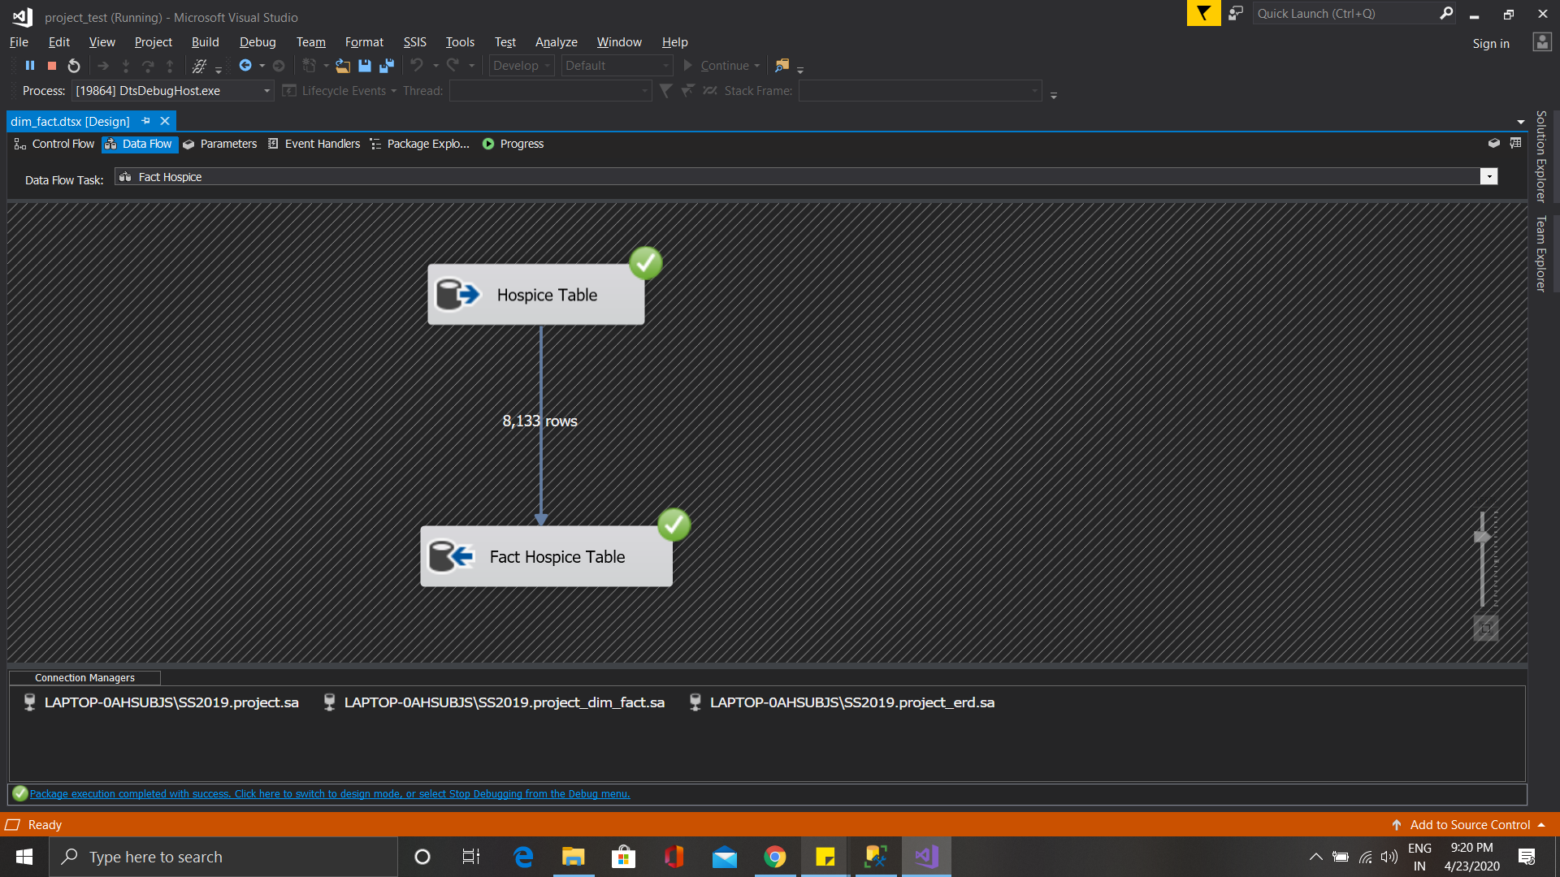
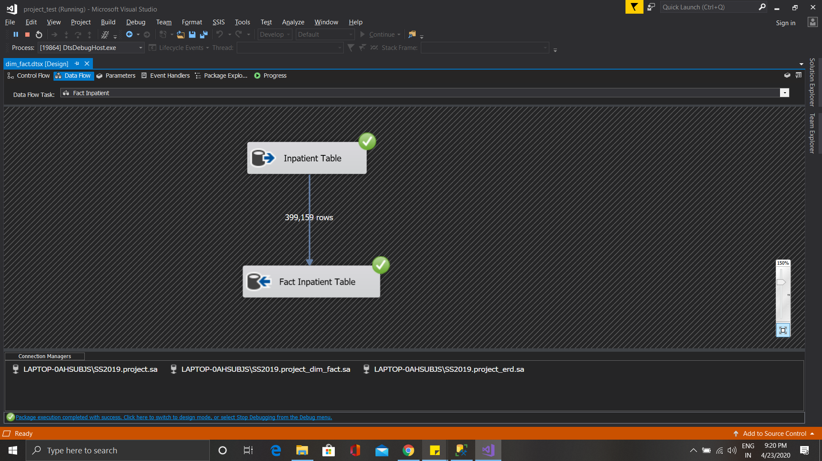
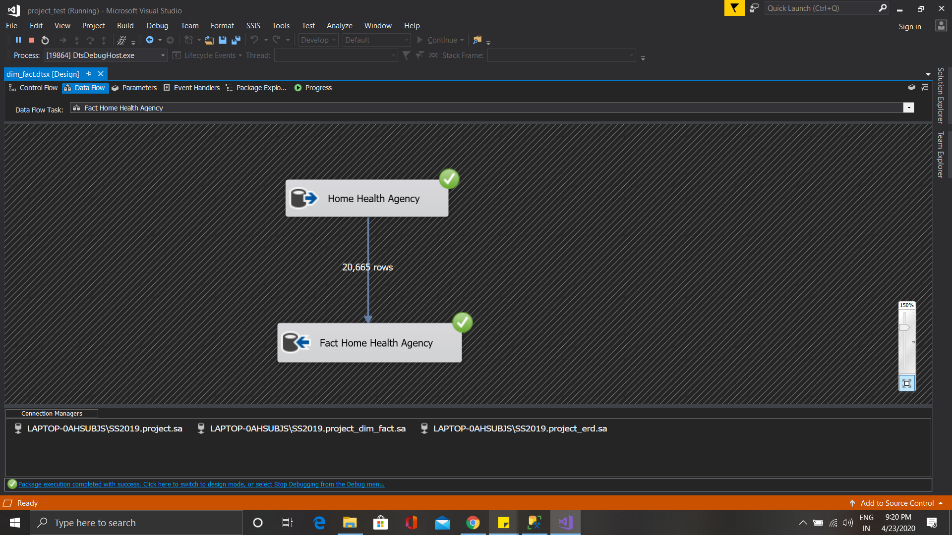
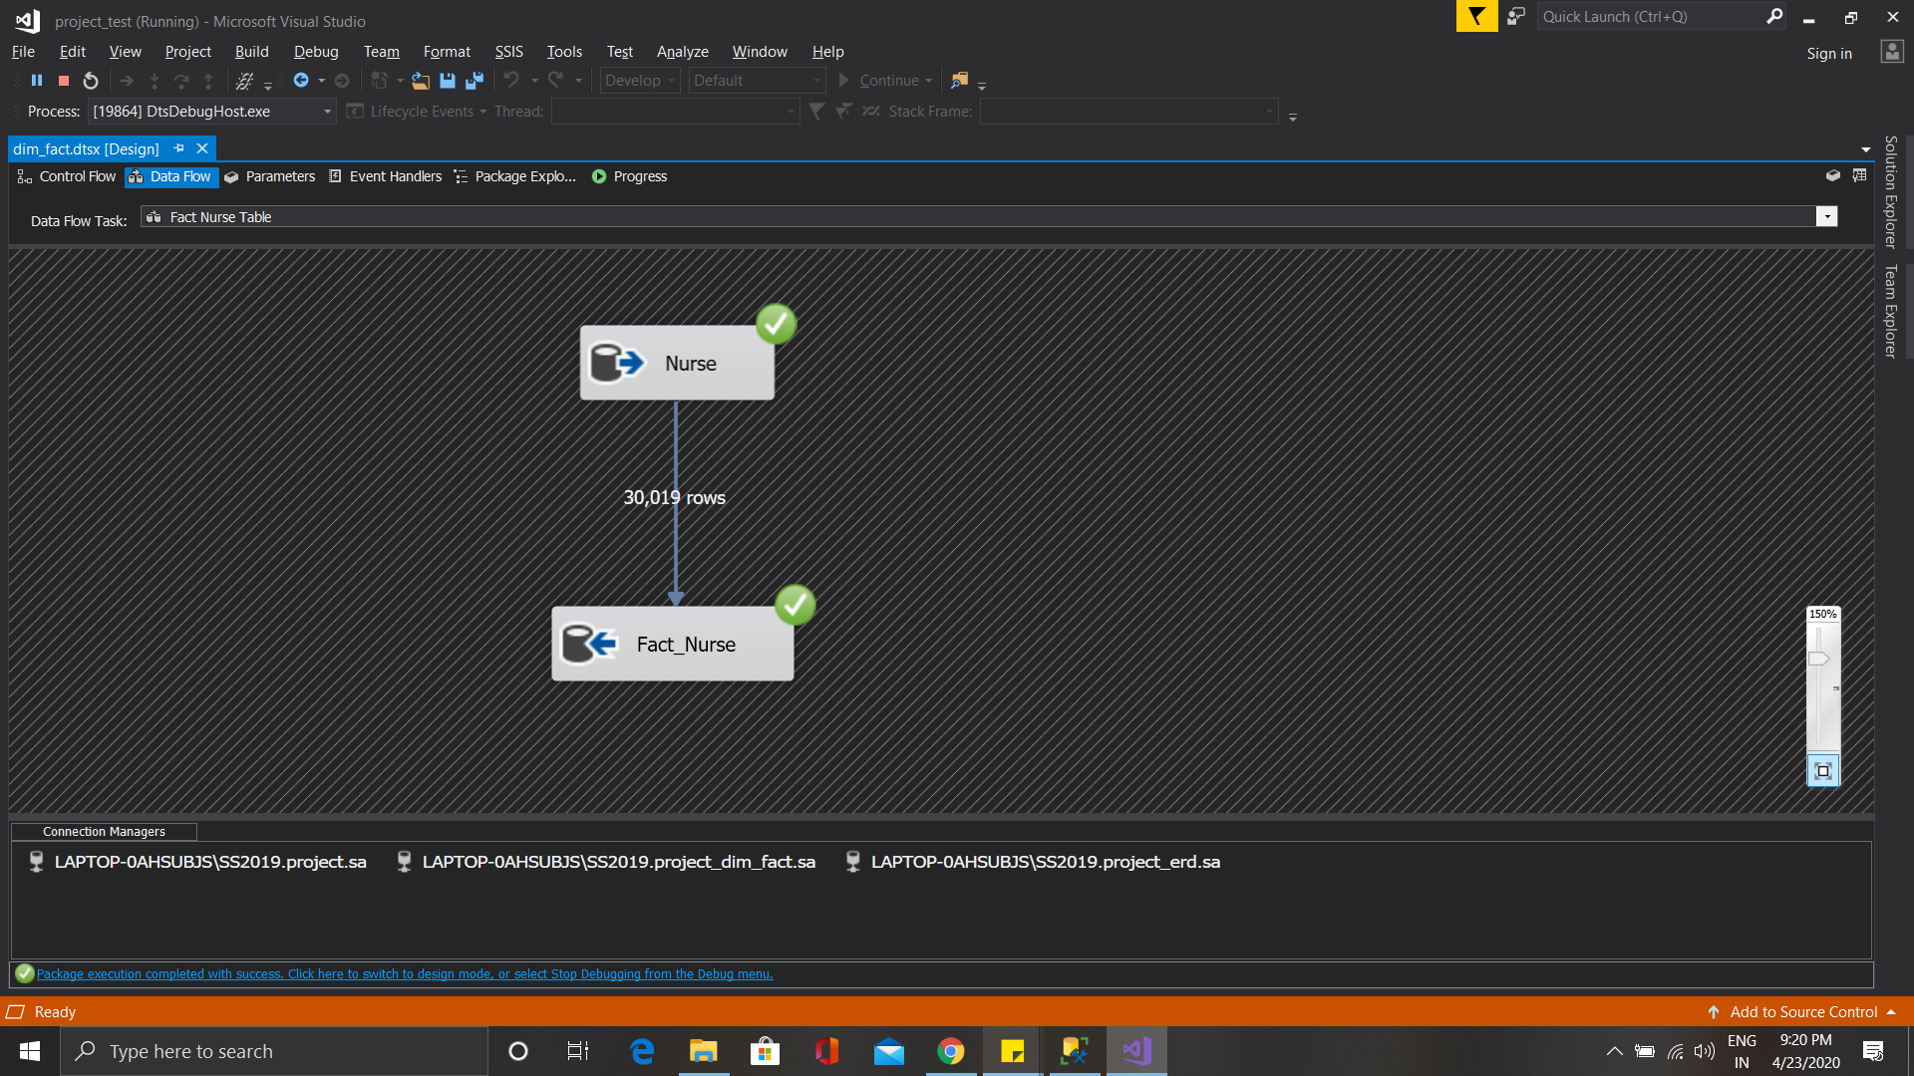
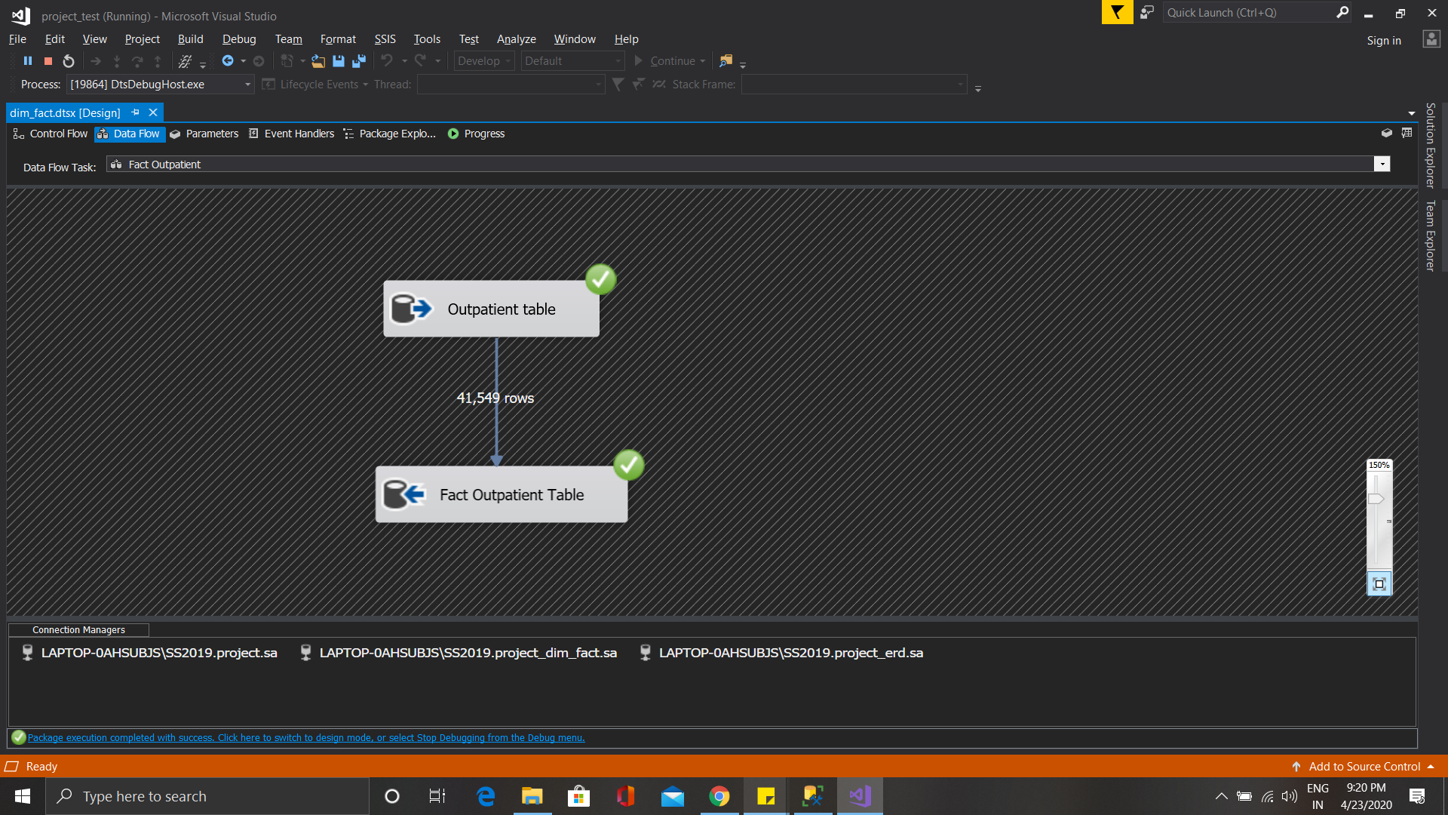
Fact Table for Fact-Dim Model

Slide 24
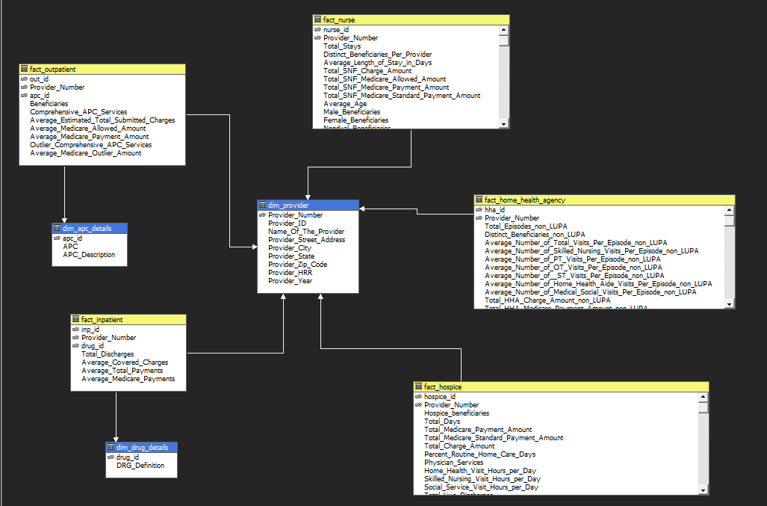
OLAP Multidimensional Cube
Software:
Visual Studio
Mode:
Multidimensional
Fact Tables: 5
Dimensions: 3
Purpose:
Cube Process
Hierarchy
Data Browse

Slide 25
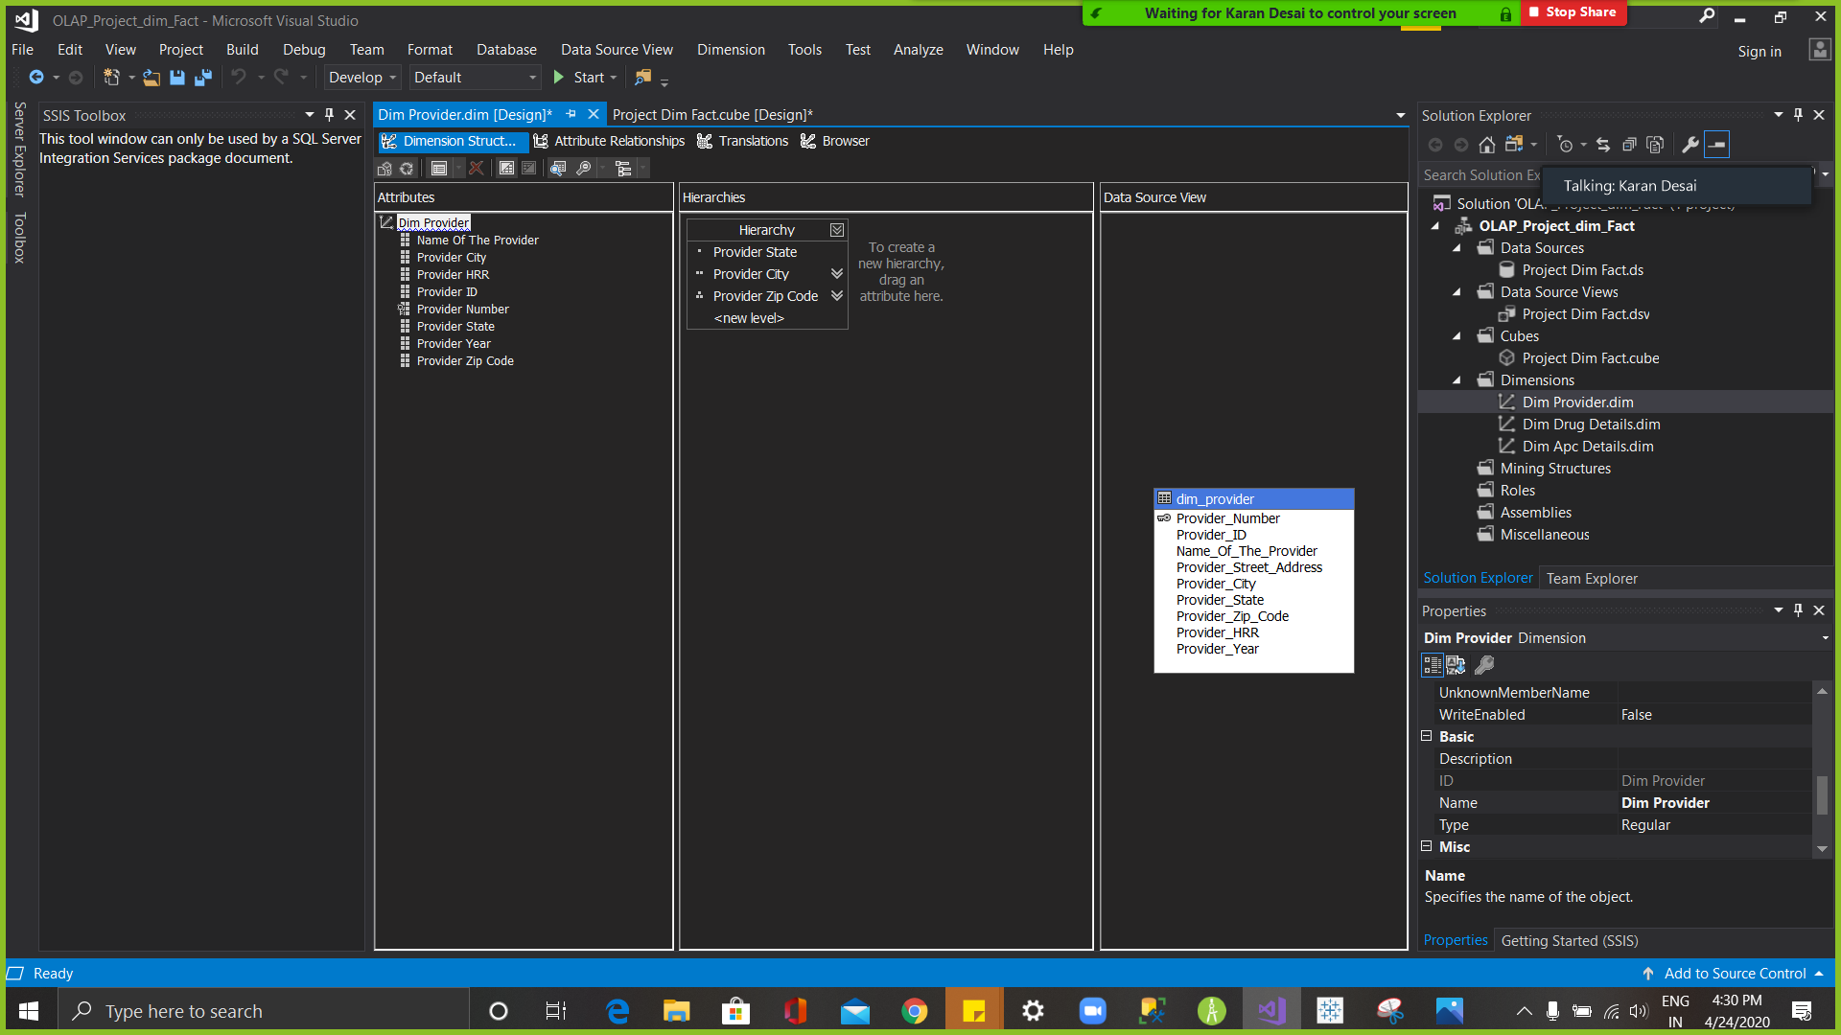
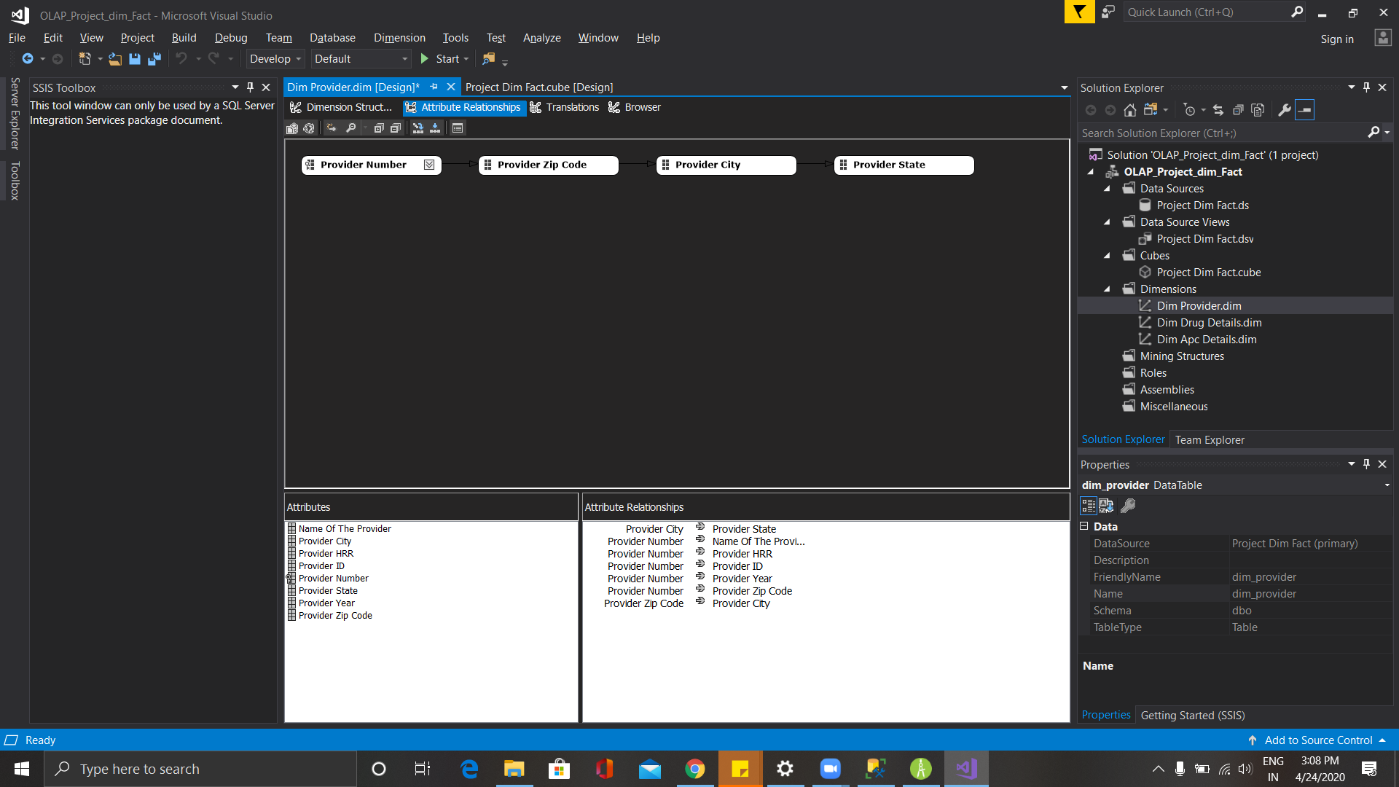
Hierarchy

Slide 26
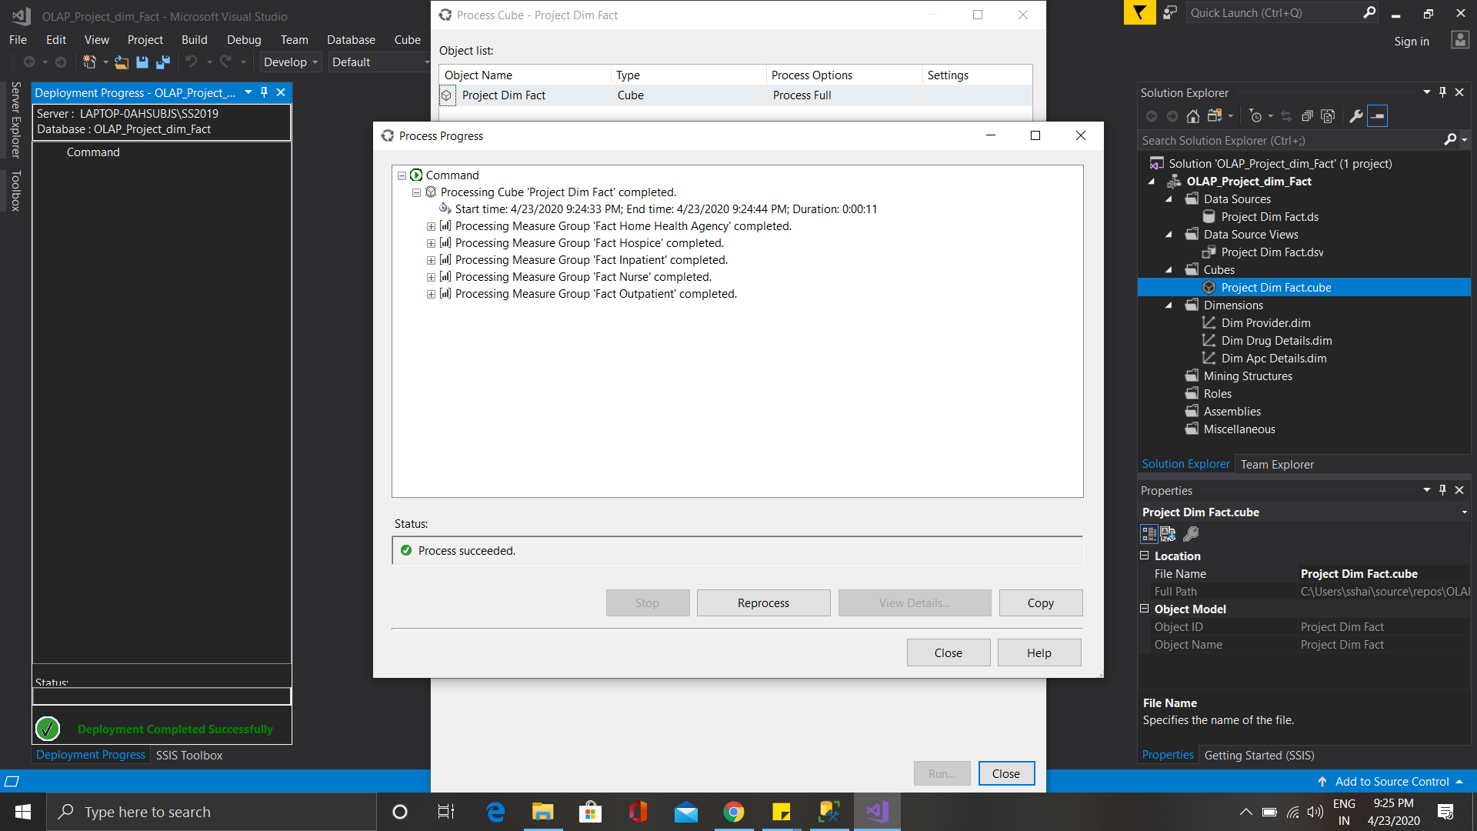
Cube Processing

Slide 27
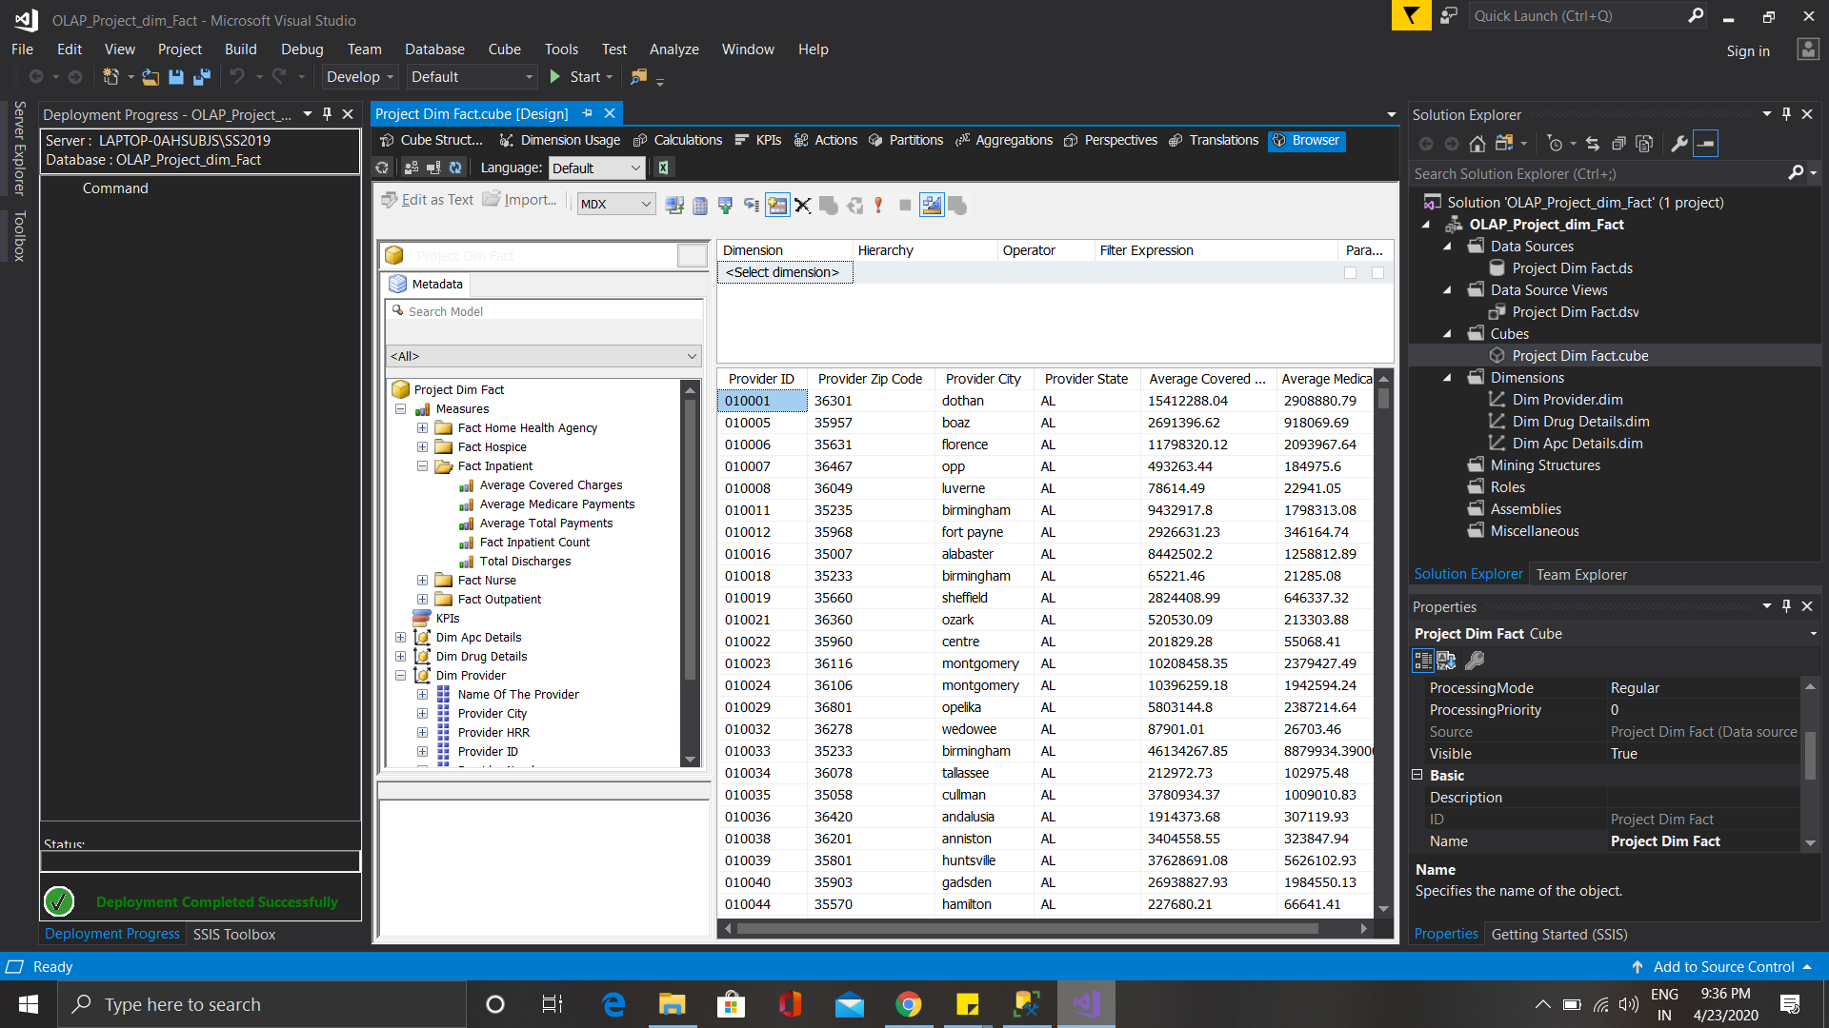
Cube Browser

Slide 28

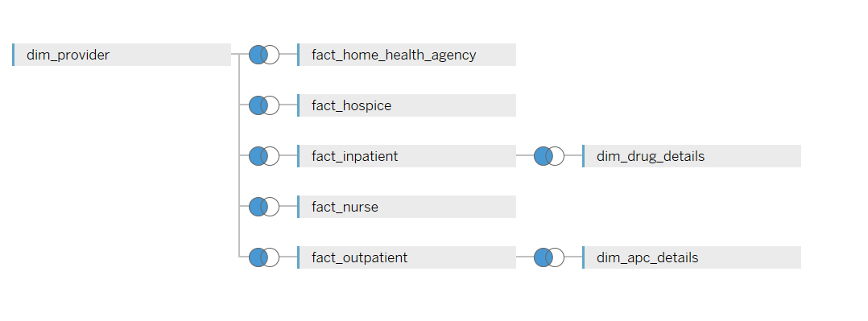
Data Visualisation

Slide 29
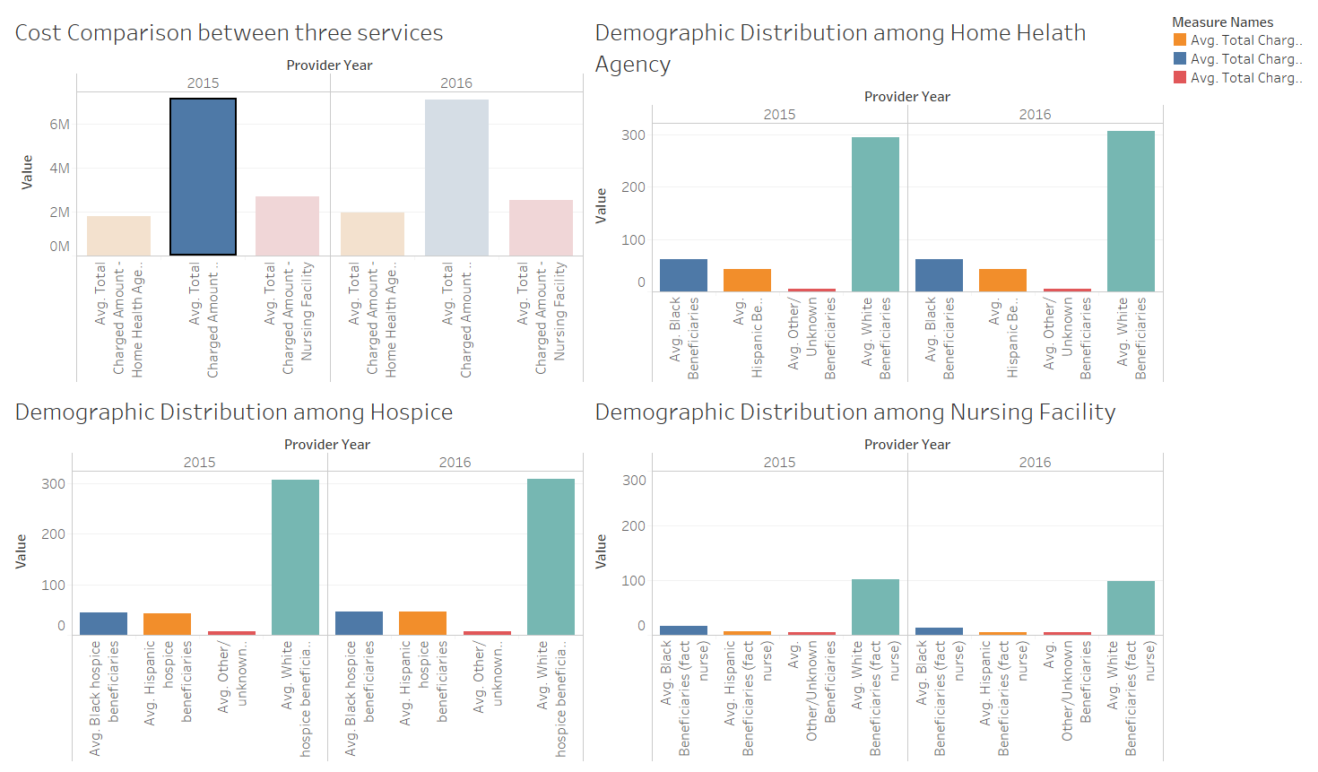
Tableau Dashboard: Health Services Comparison

Slide 30
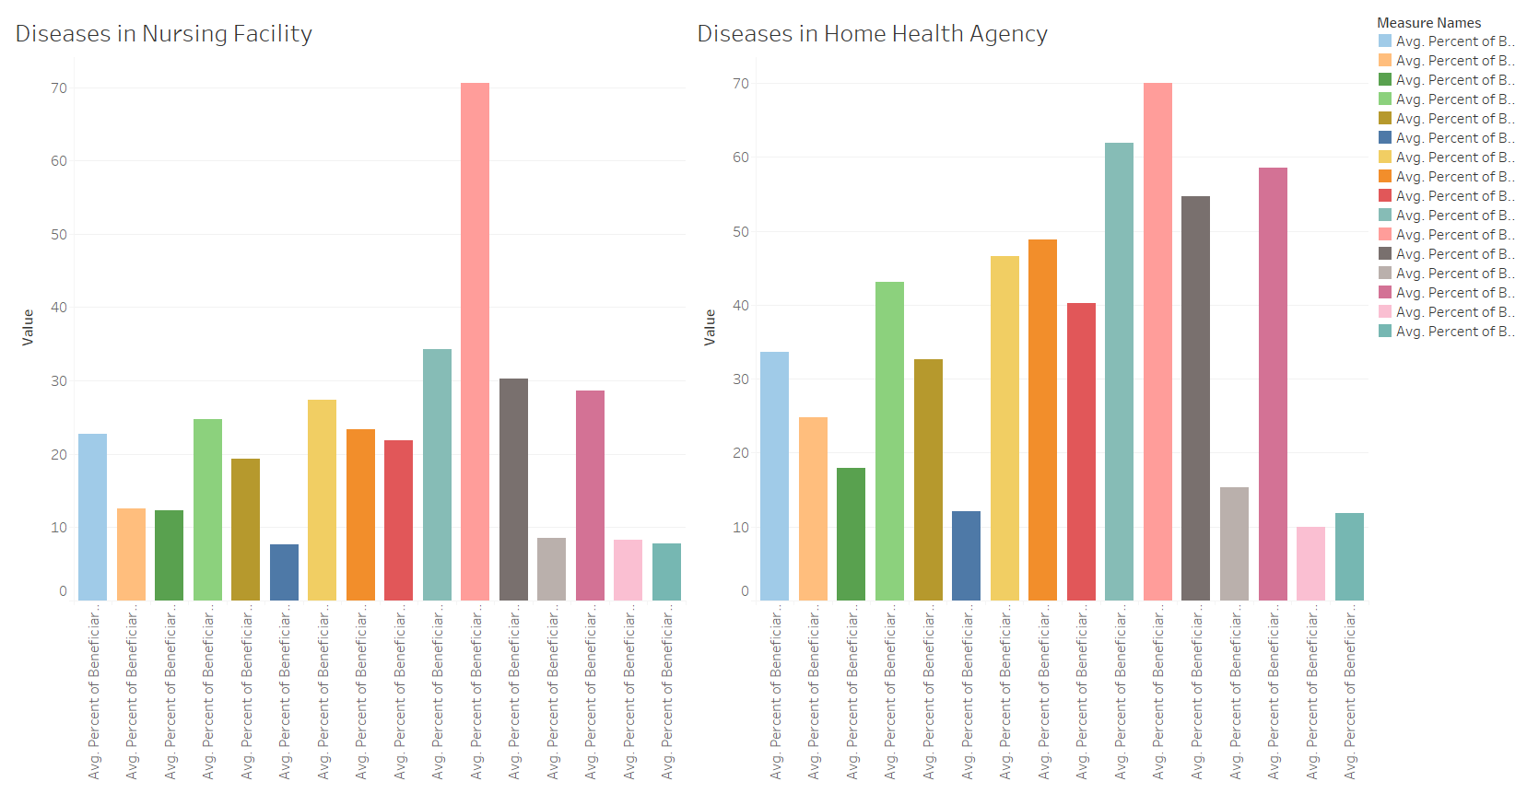
Tableau Dashboard: Disease Comparison in Nursing and Home Health Agency

Slide 31
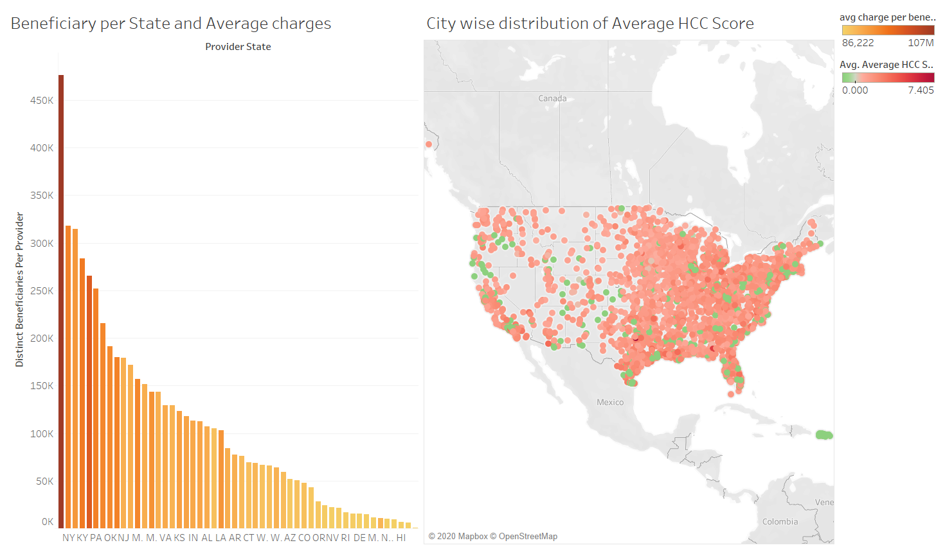
Tableau Dashboard: Beneficiary Distribution and their HCC Score

Slide 32
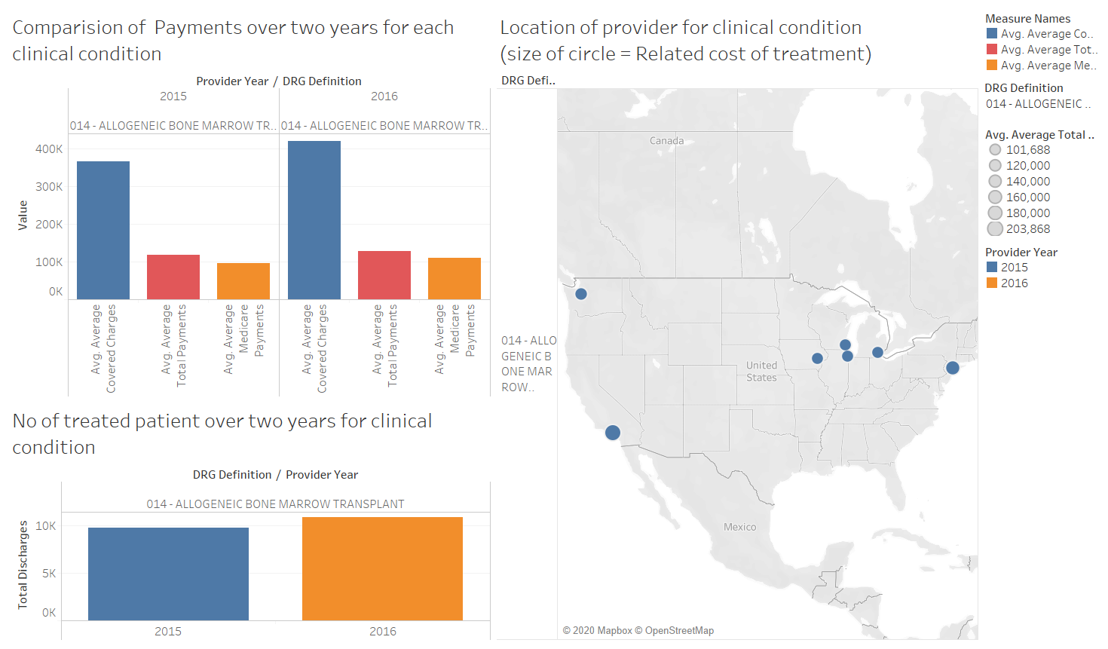
Tableau Dashboard: Drug Definition wise Payment, Discharge and Provider Distribution

Slide 33


